Slide 1
Distillation

Slide 2
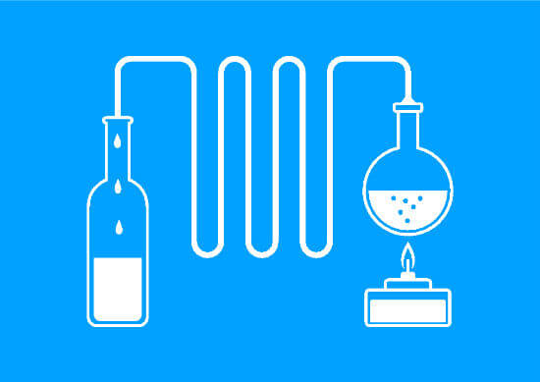
By the end of this lesson you should be able to:
1. | State when we use distillation.
2. | Explain what fractional distillation is.
3. | Explain what cold distillation is.

Slide 3
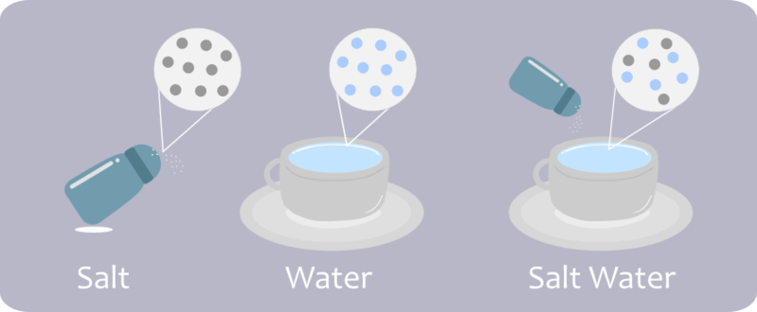
We've seen what to do when we want to keep the solute, but what about when we want to keep both the solute and the solvent?

Slide 4
Every substance has a different boiling point.
A boiling point is the temperature at which a liquid becomes a gas.

Slide 5
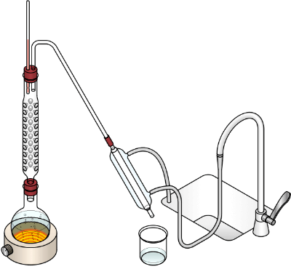
If two substances with significantly different boiling points are mixed together, we can use this property to separate them.
If we heat the mixture to the lowest boiling point, this substance will evaporate from the mixture, leaving the other behind.
This is called distillation.

Slide 6
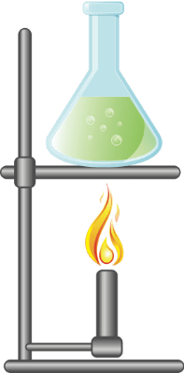
For example:
Water has a boiling point of 100∘C and ethanol has a boiling point of 78∘C.
If we heat the mixture to 78∘C, we will boil away the ethanol but leave the water as a liquid.

Slide 7
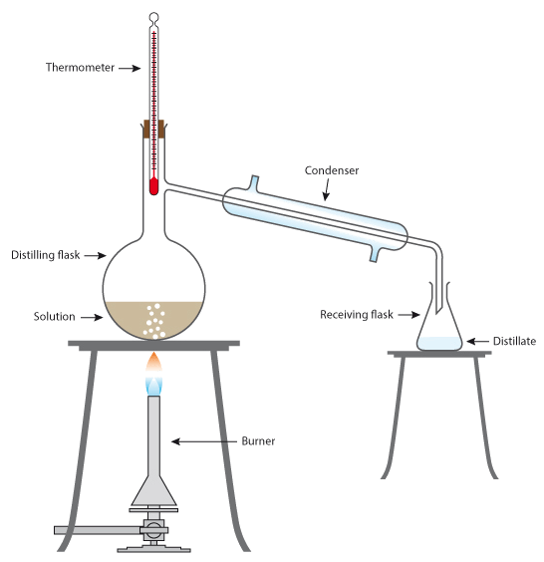
Ethanol will leave the solution as a gas and we trap it in a cooled pipe called a condenser.
The gas turns into a liquid again as it is condensed and we call this liquid the distillate.
Solids will generally be left behind because they have high boiling points. They are left as a solid or liquid (if they melt) in the original container.

Slide 9
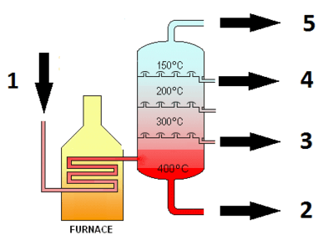
Fractional distillation is used when the boiling points of the solutes and solvents are very similar.
The solution is put into a distillation column, where different sections of the column have different temperatures.
The various gases produced will condense at the different heights (depending on their boiling point) and are then collected separately.

Slide 10
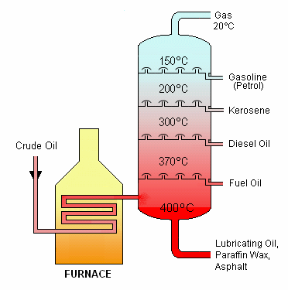
Fractional distillation is commonly used to separate crude oil.
As we can see below, crude oil is made of many different substances. Each of these substances condenses at different temperatures.

Slide 11
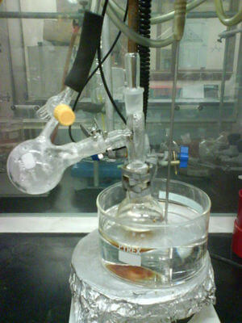
Cold distillation, which is also known as vacuum distillation, is used to separate solutions that have very high boiling points.
It works by reducing the pressure above the mixture. This lowers the components' boiling points to a temperature that is easier to create in the lab. The solution is boiled at this lower temperature; then regular distillation takes place.

